Slide 3
www.thebibleproject.com/view-resource/204

Slide 4
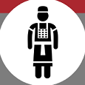
P R I E S T S
Origins of the Priesthood
Two instances of “priest” (kohen) used prior to Ex. 28:
Melchizedek, priest of Salem (Gen. 14:18)
Jethro, priest of Midian (Exod. 2:16; 18:1)
Foreshadowing the priesthood in the Exodus story:
As representatives and speakers for God (Exod. 4:14-16, 30-31; 7:1-2)
As keepers of sacred memorials (Exod. 16:33-34)
As judges of the people (Exod. 16:13, 21, 26)
As teachers of statues, laws and the need for obedience (Exod. 16:19-20)
Able to commune with God in His presence (Exod. 24:9-11)
← Consider each role in light of:
The Aaronic priesthood
Jesus, our High Priest
Our role as a “nation of priests”

Slide 5
P R I E S T S
Origins of the Priesthood
Priesthood commanded as part of the covenant in Exod. 28-29:
“Have your brother, Aaron, with his sons, come to serve Me as priest – Aaron, his sons Nadab and Abihu, Eleazar and Ithamar.” - Exod. 28:1 | “I will consecrate the tent of meeting and the altar; I will also consecrate Aaron and his sons to serve Me as priests. I will dwell among the Israelites and be their God. And they will know that I am the Lord their God, who brought them out of the land of Egypt, so that I might dwell among them. I am the Lord their God.” - Exod. 29:44-46

Slide 6
P R I E S T S
Duties of the Priesthood
Preside at sacrifices (Lev. 1:5, 7-9, etc.)
Supervise preparation of incense and anointing oil (Num. 4:16)
Offer incense on the altar of incense in front of the veil - High Priest only! (Exod. 30:7)
Trimming and lighting the golden candlestick (Exod. 30:8)
Oversee travel preparations for the tabernacle (Num. 4:5-33)
Judge difficult cases (Deut. 17:8-13)
Teach the law of God to the people (Deut. 17:10-11; 33:8-10)
Keep copies of the law and read it at appointed times (Deut. 31:9-13)

Slide 7
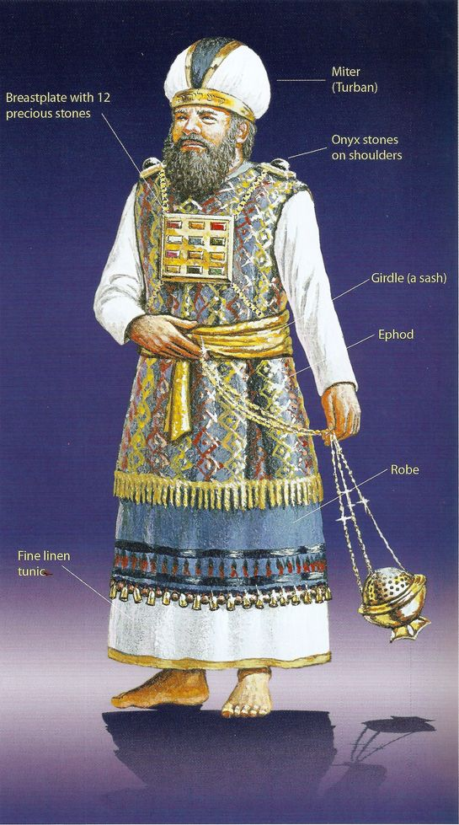
P R I E S T S
Priestly Garments
High Priest (Aaron) Linen undergarment Tunic (coat) Robe Ephod Breastplate Turban (miter) Gold plate “Holy to the Lord” Sash (girdle) | Priests (Sons of Aaron) Linen undergarment Tunic (coat) Sash (girdle) Turban

Slide 8
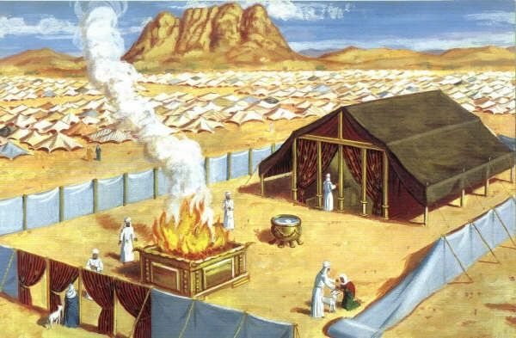
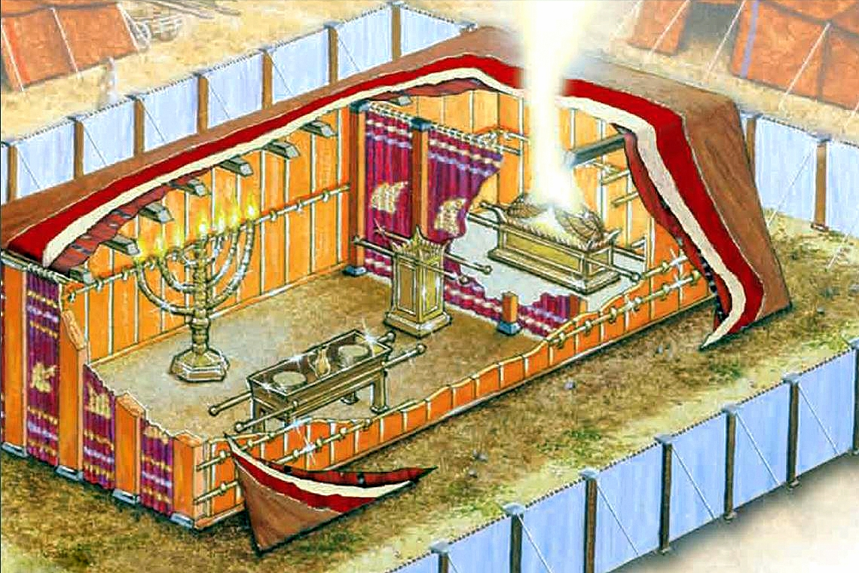
P R I E S T S
The Tabernacle

Slide 9
P R I E S T S
Consecration of the Priests (Lev 8-9)
“…just as the Lord had commanded”
Just as with the tabernacle (Exod. 40), the appearing of the Lord’s glory is preceded by the people having done everything according to His instruction
Exod. 38-40 – repeated 17x
Lev. 8-10 – repeated 15x
To know the Lord’s will is a great blessing… and a great responsibility!
The elaborate ordination ceremony emphasizes the intentionality and care to be taken in worshiping the Lord
The vestiture and consecration of the priests and the atonement offerings took place in full view of the community… (ch 8-9)
…as did the penalty for treating the Lord’s commands with contempt (ch 10)

Slide 10
P R I E S T S
Nadab and Abihu (Lev 10)
The specifics of “strange/profane fire” aren’t disclosed
Educated guesses have been made based on the text
Encroaching on Aaron’s duties? Intruding into God’s presence? Improper fire/incense source? Drunkenness?
But disregard for God’s holiness is in sharp focus
“By those who come near Me, I will be treated as holy. And before all the people I will be honored.”
(10:3, NASB)
(Consider the events of Acts 5:1-11 in light of this incident)
The seriousness of holiness runs throughout the NT:
Luke 12:48
“…to whom much is given, much is required.”
1 Pet. 4:17
“Judgment begins with the household of God.”
Jas. 3:1
“We who teach shall be judged with greater strictness.”
1 Pet. 2:9
“But you are a chosen people, a royal priesthood, a holy nation, a people belonging to God, that you may declare the praises of Him who called you out of darkness into His wonderful light.

